Slide 1


Department of Mechanical and Manufacturing
University of Ruhuna
HOME POWER SAVING
DOOR LOCK SYSTEM
GROUP 17
EG/2021/4476 – N.A.A DHANANJAYA
EG/2021/4717 – W.S.R.K. PERERA
EG/2021/4763 – H.S.D RODRIGO
EG/2021/4766 – R.P.J RUKSHAN
ME 3201: Engineering Design Methodology

Slide 2


GROUP 17
Agenda
1
Introduction
2
Methodology
3
Questionnaire
4
Objectives
5
Design
6
Results & Discussion

Slide 3


Introduction
INTRODUCTION
  There are power saving systems that will interrupt the unwanted power supplies when no one is at home.
  The challenge was to design a component that work accurately in recognizing the presence of people in the house.
  So, we designed a door lock that can accurately recognize the presence of people in the house by adding a small function.
Back to Agenda

Slide 4
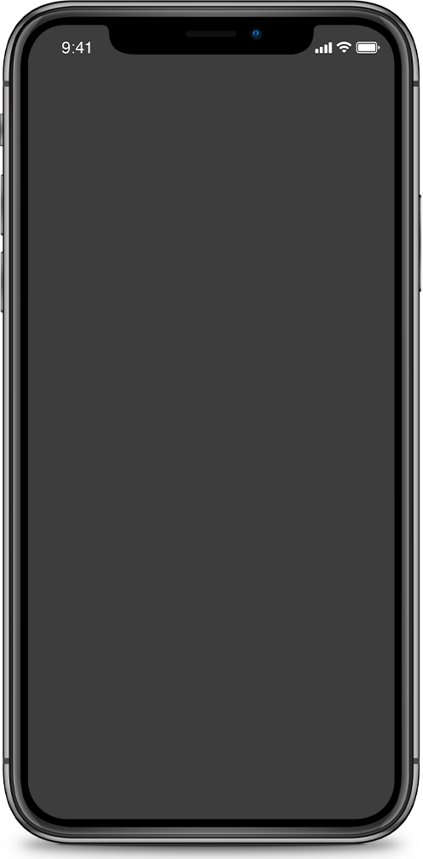


Methodology
Back to Agenda
METHODOLOGY
Survey
To gather valuable insights for the project, a comprehensive survey was conducted among university students.

Slide 5
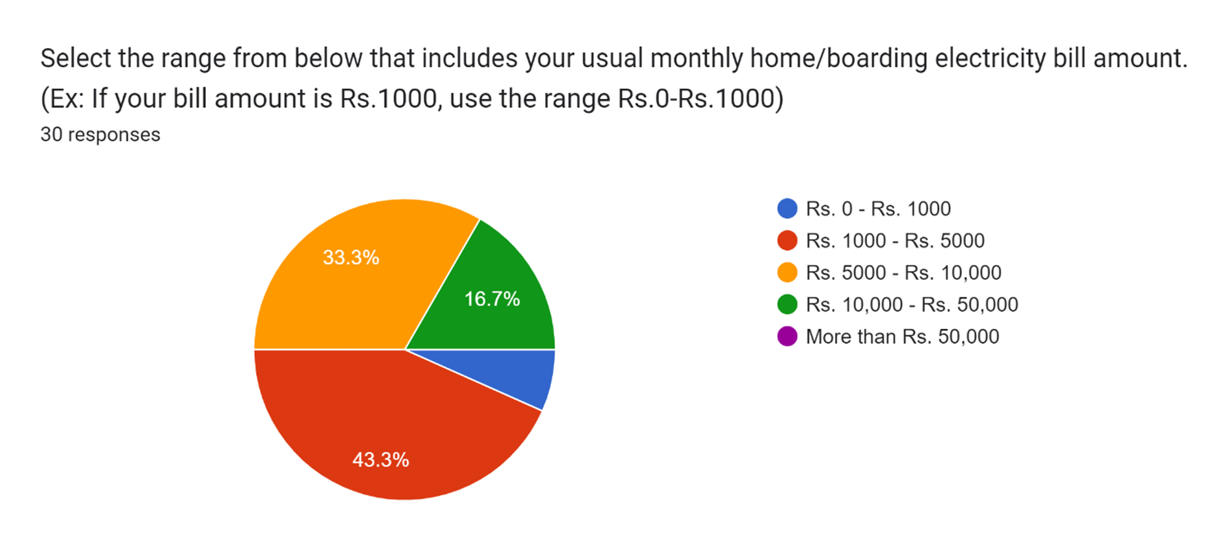

Questionnaire
Back to Agenda

Slide 6
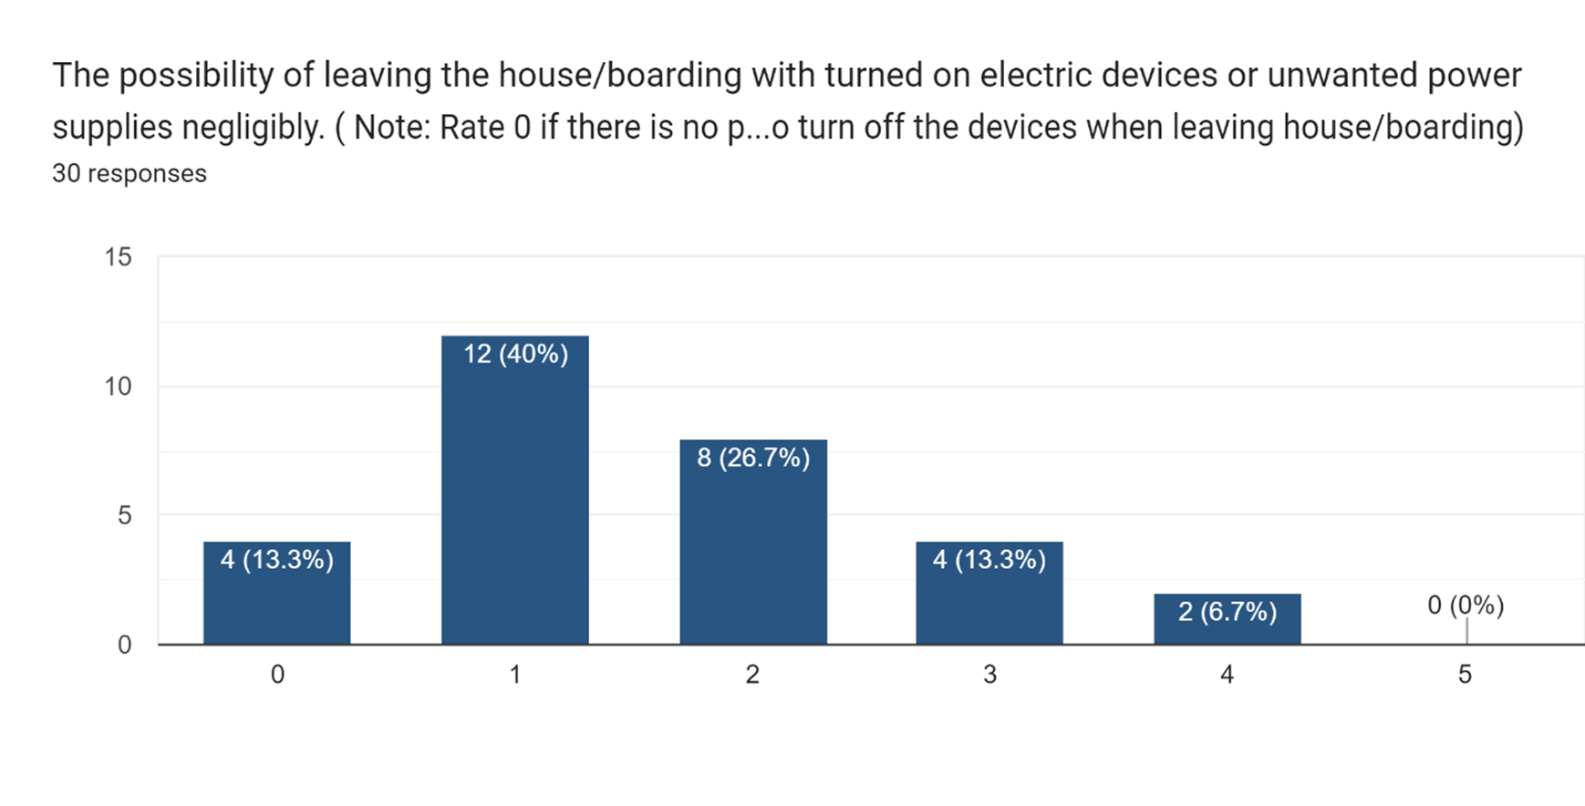
Questionnaire
Back to Agenda

Slide 7
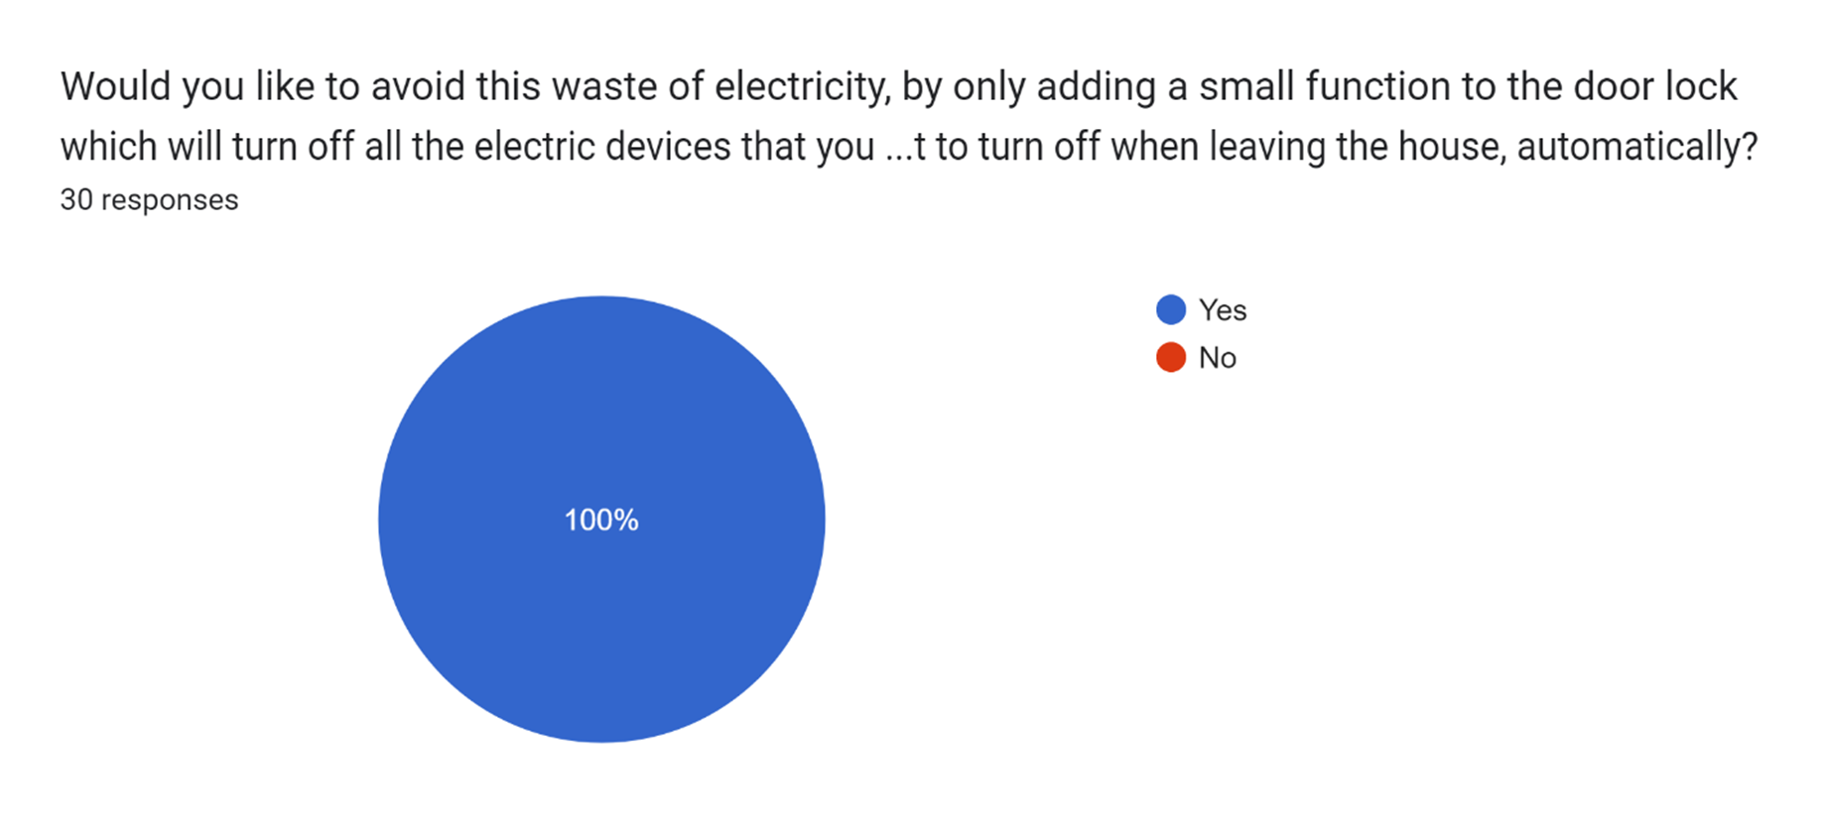
Questionnaire
Back to Agenda

Slide 8

Objectives
OBJECTIVE TREE
OBJECTIVES
FUNCTIONAL ANALYSIS
MORPHOLOGICAL ANALYSIS
Back to Agenda

Slide 9
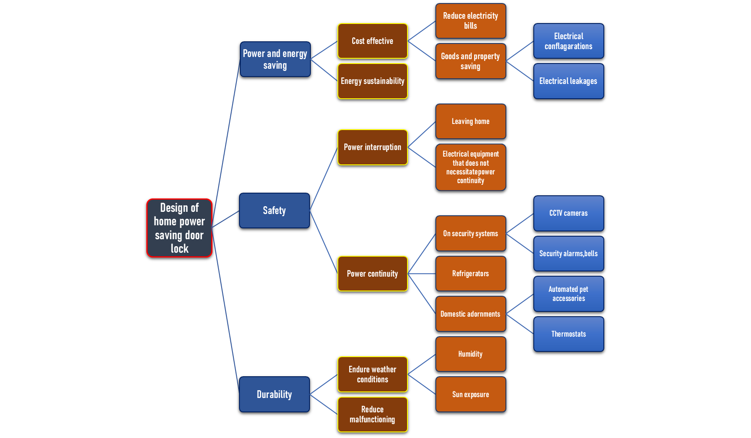

Objectives
Objective Tree Method
Back to Agenda

Slide 10

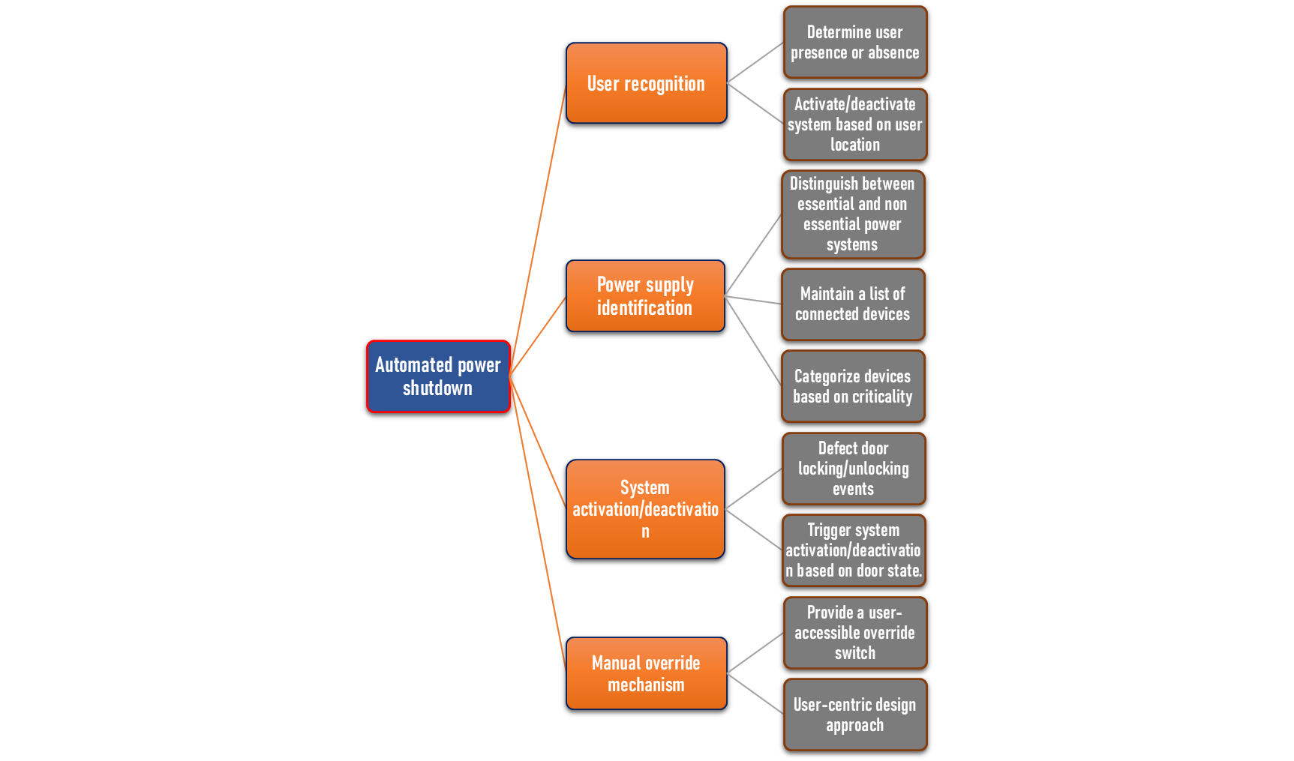
Objectives
Functional Analysis
Back to Agenda

Slide 11
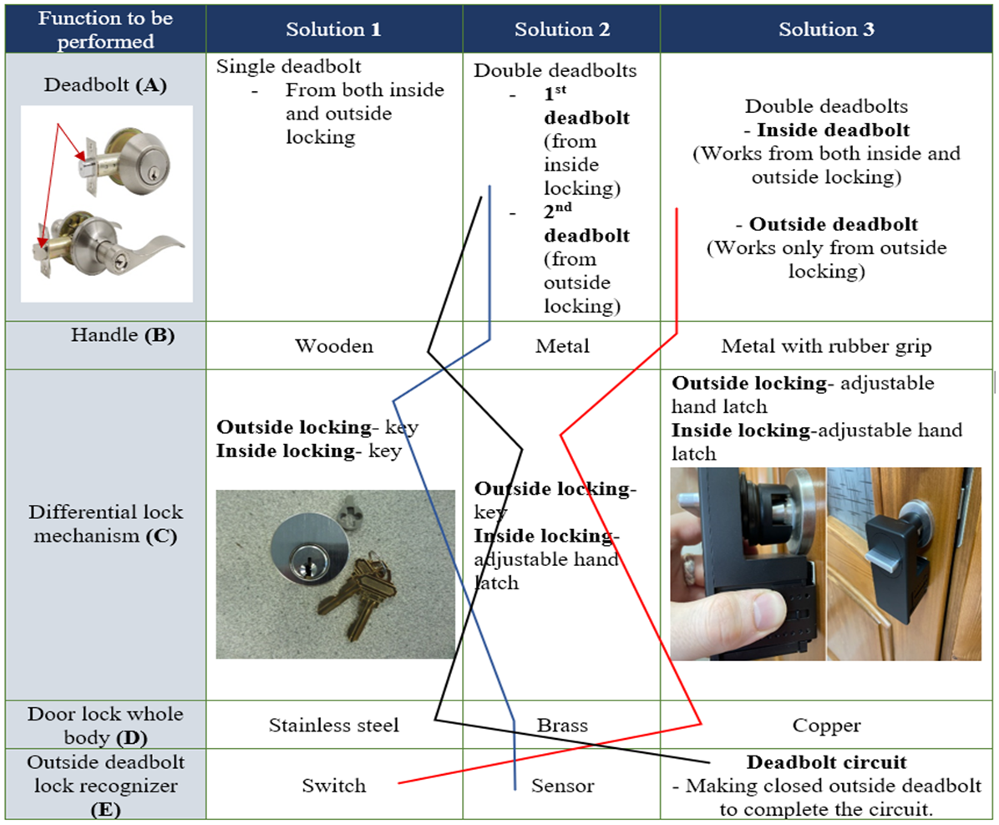


Objectives
Morphological Analysis
Back to Agenda

Slide 12
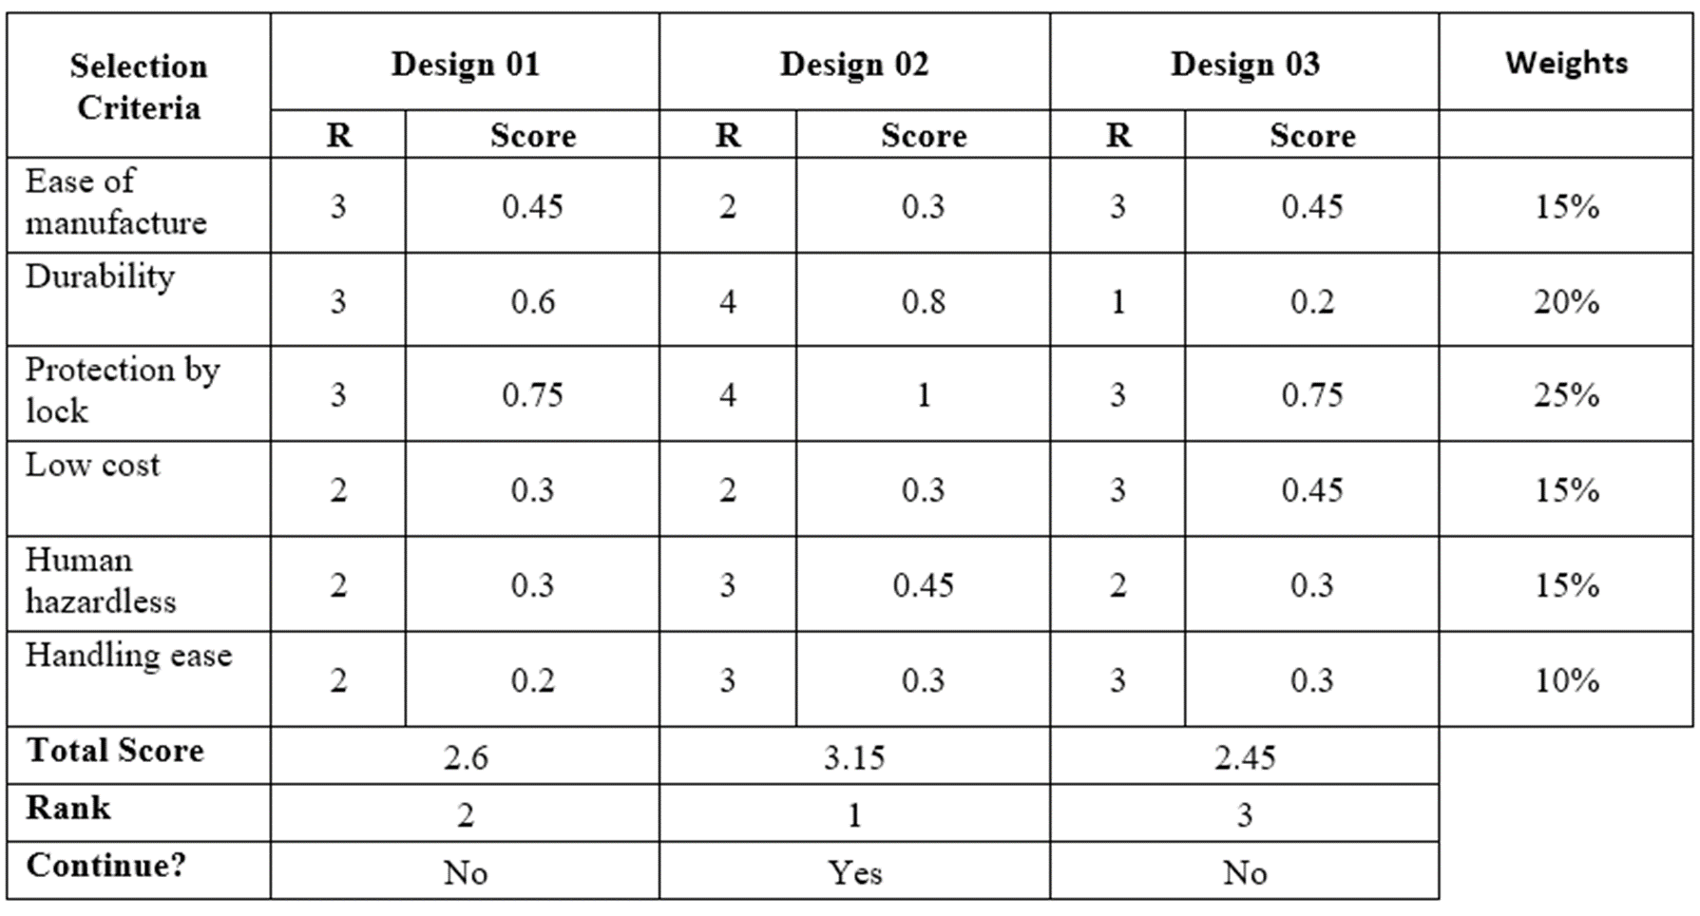

Weighted Decision Matrix
Back to Agenda

Slide 13




















DESIGN

Slide 14

We made a differential lock that can lock the door from inside and outside separately by adding separated deadbolts for each lock.
RESULTS & DISCUSSION
No one locks the door from the outside if people did not leave the house.
By locking from the outside of the door, a signal is sent to the system indicating that there are no one in the house.

Slide 15

Those selections were made mainly according to following criteria.
  Durability
  Protection by lock
  Human hazardless
RESULTS & DISCUSSION
To achieve the maximum efficiency and benefit, the perfect design was selected through the solutions we had.
So, the power saving system will turn on when no one is at home.

Slide 16
CONCLUSION
  Survey shows that the energy wastage costs a lot and mostly happens when unwanted power supplies are ongoing while no one is at home.
  It also says that people like a home power saving door lock system as a solution for this.
  So, this door lock will save the money and also the energy.

